Slide 1


Slide 2

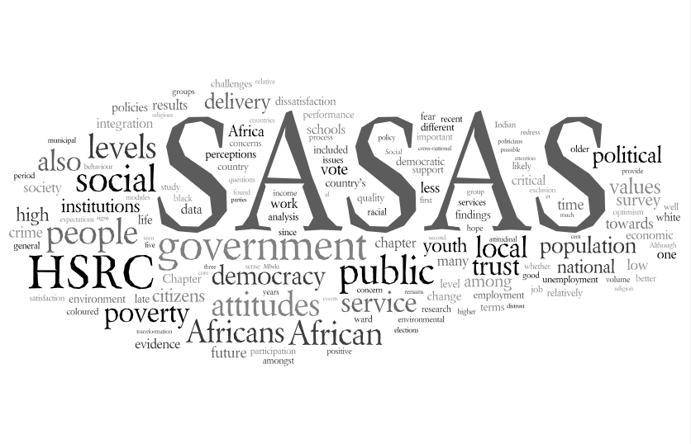
Human Sciences Research Council
Lekgotla la Dinyakisišo tša Semahlale tša Setho
Raad vir Geesteswetenskaplike Navorsing
Umkhandlu Wezokucwaninga Ngesayensi Yesintu
Ibhunga Lophando Ngenzulu-Lwazi Kantu
South African Social Attitudes Survey (SASAS)
An Overview
Benjamin Roberts
Research Colloquium on Post-School Education and Training (PSET)
4th November 2014
Pretoria
www.hsrc.ac.za

Slide 3
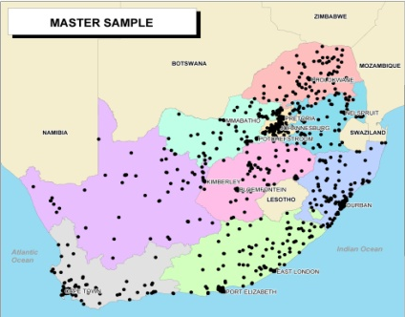
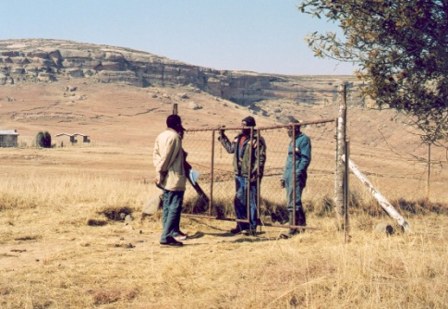
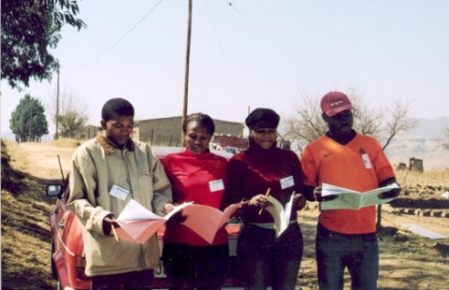
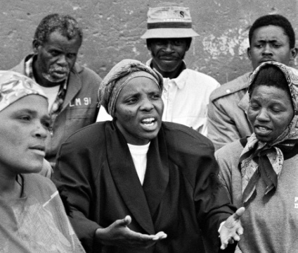
South African Social Attitudes
Survey (SASAS)
History:
Repeated cross-sectional survey
Conducted annually since 2003. Round 11 in late 2013
Developed with international and local assistance
Modelled on similar long-standing attitudinal survey series in the UK (BSA), USA (GSS) and Germany (ALLBUS)
Broad aims:
Produce rigorous trend data about changes in people’s underlying values
  Achieve recognition for reliable social indicators and attitudinal measures
  Increase collaboration with cross-national surveys to provide a comparative component to our understanding of our society

Slide 4
Sample design
Sampling frame: Each SASAS round consists of a nationally representative sample of 7,000 individuals aged 16 and older in private households across the 9 provinces
500 Census enumeration areas (EAs) are drawn as primary sampling units (PSUs)
  Then, 14 visiting points are selected in each EA
  Lastly, one eligible respondent is randomly chosen
Split sample design is used:
  Two questionnaires are administered to 3,500 target respondents each to allow for increased content
  2012: 3 questionnaires used due to DST supported special family-focused instrument
Mode of interview: face-to-face
Data collection: Oct-Dec each year
Select PSUs
500 Census EAs
Select SSUs
14 visiting points per EA (7 per questionnaire)
Select USUs
1 person per visiting point

Slide 5
SASAS content
Questionnaires contain:
  A core module, repeated each round to monitor change and continuity in a variety of socio-economic, political and cultural variables
  Rotating modules on specific themes to provide detailed attitudinal evidence to inform policy and academic debate
  Standard demographic and background variables
Content focuses on key perennial topics to provide reliable measures to better understand contemporary South Africa
SASAS: an instrument for identifying and interpreting long-term shifts in social circumstances and values, rather than simply monitoring short-term changes

Slide 6
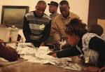




Dynamic Tool for Policy-Makers
The survey demonstrates utility as an anticipatory, or predictive mechanism
…helps us understand the socio-political climate in which we live our lives and form our views
. …exposes society’s political and cultural divisions, eg unequal opportunities, intolerance
…enables impending changes in behaviour patterns to be detected early
The survey can inform decision- and policy-making processes.
The series is playing an increasingly salient role in the policy domain
Extensive experience in undertaking nationally representative surveys on civic participation and democratic institutions

Slide 7
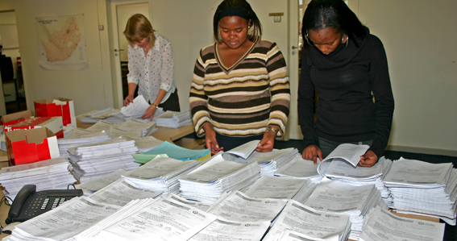

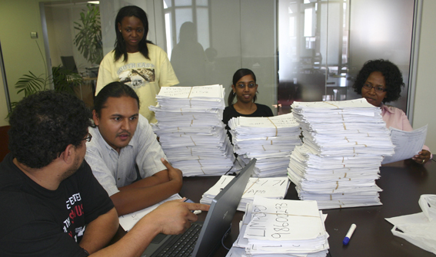
Core Principles for Module Design
Backward Comparability
In choosing indicators for inclusion, where possible attention should be devoted to ensuring backward comparability
Involves examining the content of other previously conducted national surveys that have included items on the topic(s) under investigation
Purpose: facilitate trend analysis, isolate value change and changes in predictors
Sources: SASAS and other older opinion surveys; official data series; SARS funded survey data collection; etc.

Slide 8
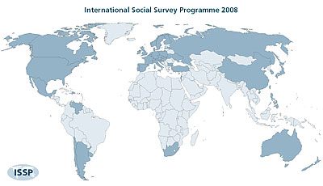

Core Principles for Module Design
Cross-national comparison
Importance of comparative research:
  Helps reveal intriguing differences between countries and cultures
  Uncovers aspects of one’s own country and culture that is difficult to derive from domestic data in isolation
  S. African exceptionalism: commonalities and differences
Involves: item identification from cross-national attitudinal time-series surveys
Preferable (but not essential) if items have been field tested in South Africa before
Sources: ISSP; WVS; AfroBarometer; BSA

Slide 9
Core Principles for Module Design
Other considerations
Weather Changes vs Climate Shifts
Ensuring consistency and continuity over time
Identify key priority themes for next 5-10 years, with policy debate and intervention in mind
Between 3 – 5 topics or themes per 20-item module
Combination of attitudinal-behavioural items
Item selection: behavioural items to juxtapose against attitudinal values (e.g. views on taxation vs. actual tax compliance)

Slide 10
International comparative capability
  For getting ahead in life…how important is having a good education yourself? (ISSP 2009)
% essential / very important
Source: South African Social Attitudes Survey (SASAS) 2009; ISSP 2009

Slide 11
Subjective Comparisons of Present and Past School Leavers
Source: HSRC South African Social Attitudes Survey (SASAS) 2013

Slide 12
The Role of Secondary Schools in Preparing the Youth
Source: HSRC South African Social Attitudes Survey (SASAS) 2013

Slide 13
Priorities for extra government spending on education?
Which of the following groups, if any, would be your highest priority for extra government spending on education?
(column percentage reflecting % of adult public)
 | 16-19 |  | 20-29 |  | 30-39 |  | 40-49 |  | 50-59 |  | 60+ |  | All
Priority Level | 1st | 2nd | 1st | 2nd | 1st | 2nd | 1st | 2nd | 1st | 2nd | 1st | 2nd | 1st | 2nd
Pre-school | 6 | 6 | 21 | 10 | 18 | 9 | 17 | 10 | 21 | 7 | 14 | 6 | 17 | 8
Primary school | 22 | 14 | 21 | 14 | 25 | 15 | 22 | 14 | 24 | 14 | 19 | 17 | 22 | 15
Secondary school | 18 | 17 | 10 | 18 | 12 | 18 | 9 | 18 | 11 | 19 | 11 | 19 | 11 | 18
Special needs school | 33 | 21 | 29 | 14 | 25 | 15 | 33 | 17 | 25 | 21 | 37 | 10 | 29 | 16
Tertiary learners | 21 | 34 | 15 | 29 | 16 | 30 | 15 | 24 | 13 | 28 | 10 | 29 | 15 | 29
Adult Basic Education | 1 | 8 | 2 | 12 | 3 | 11 | 2 | 13 | 3 | 9 | 5 | 12 | 3 | 11
Total | 100 | 100 | 100 | 100 | 100 | 100 | 100 | 100 | 100 | 100 | 100 | 100 | 100 | 100
Source: HSRC South African Social Attitudes Survey (SASAS) 2013

Slide 14
Language Preferences in
Different Education Levels
Source: HSRC South African Social Attitudes Survey (SASAS) 2013

Slide 15
National Pride in South Africa
Source: HSRC South African Social Attitudes Survey (SASAS) 2013

Slide 16
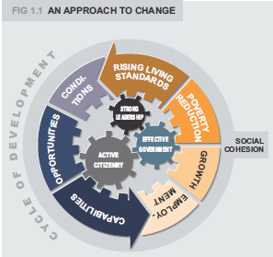
Strategic importance, linkages and impact
Link to National Development Plan
NDP identifies a series of fault lines which need to be addressed to promote nation building
SASAS is examining many of these issues as part of annual data collection
  Social cohesion; quality of life and living standards; views on democracy, governance and politics; etc.
Links to M&E Plan / Government Outcomes
  SASAS generates knowledge that is able to inform progress against Government Outcomes, especially Outcome 12.
    Outcome 3, Output 4: Manage perceptions of crime among the population
    Outcome 12 part A, Output 1: Service delivery quality and access
    Outcome 12 part B, Outputs 1-3: Nation Building and National Identity; Citizen Participation; Social Cohesion
Nation building fault lines
Nation building fault lines

Slide 17
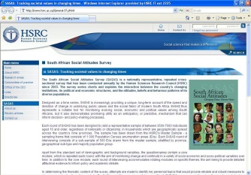
Strategic importance, linkages and impact
Departments / national entities / other users using results
  During ten years of existence, been increasing interest in, support for, and usage of SASAS data by departments and national entities
  SASAS web portal (www.hsrc.ac.za/sasas), strategic use of HSRC Review, and SASAS book series key in increasing policy uptake
Who should be benefitting that is not yet involved
  Increased uptake by DPME, Social Cluster and Parliament
  Increased uptake by students and academics
Potential link to other surveys; data mining:
  Increasing engagement with other national and cross-national surveys in key thematic areas is being planned
  Allow for increased robustness checks on findings
  Allow for increasing benchmarking of South African attitudes against those in other nations

Slide 18
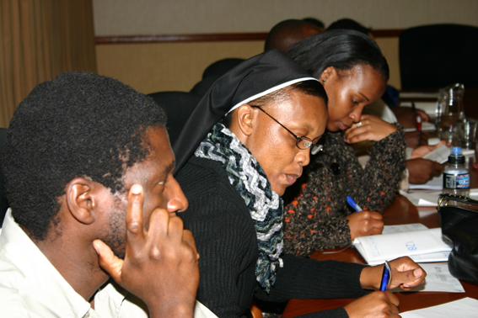

SASAS and Opportunities for PHET
Data dissemination: promoting data usage at universities for the purposes of instruction and studies
Source material for dissertations and peer reviewed publications
Providing students and researchers with skills in:
  analysis of microdata
  survey methodology
Archived data freely downloadable off HSRC’s SASAS website
www.hsrc.ac.za/sasas

Slide 19
Parting thoughts
The SASAS analysis to date has served to …
  Highlight the importance of tracking social attitudes to understanding the extent and nature of changing values in our diverse society
  Indicate the benefit of international benchmarking
Given the broad thematic content and increasing scope of SASAS trend data, it is becoming increasingly important to build up a community of users to interrogate, question and debate
In this spirit, SASAS data is available in the public domain
www.hsrc.ac.za/sasas

Slide 20
thank you
contact information
  For more info, please contact us at
Benjamin Roberts Jarè Struwig
SASAS Coordinator SASAS Coordinator
Tel: (031) 242 5606 Tel: (012) 302 2511
Cell: 084 523 0374 Cell: 082 774 5749
email: broberts@hsrc.ac.za email: jstruwig@hsrc.ac.za

