Slide 1
Skills Mismatch and Informal Sector Participation among Educated Immigrants: Evidence from South Africa
Alexandra Doyle
Amos Peters
Asha Sundaram
Presented at
HSRC LMIP Seminar Series
October 30, 2014

Slide 2
Aim
We look at employment outcomes for immigrants relative to natives in the SA labour market.
Particularly, we show that:
conditional on education, immigrants from different countries have different likelihoods of being employed
in a skilled job
in the informal sector
Argue that this is evidence for ‘brain waste’.
We study correlations between outcomes and origin-country characteristics

Slide 3
Motivation
Immigrants can contribute to the host country labour market by bringing:
Diversity
Skills
Poor absorption of immigrants into the labour market can lead to:
‘brain waste’: relevant for developing host countries
expanding informal sector/unemployment
issues like increasing crime, related to the above

Slide 4
Literature
Large literature on immigrant performance and assimilation in host country labour markets, focusing on employment, wages.
Borjas, 1994; Borjas, 2003; Ottaviano and Peri, 2012
It is important to look at quality of jobs.
Mattoo, Neagu & Ozden, 2008; Bourgeault et al., 2010; Carr, Inkson & Thorn, 2005
Literature has focused on developed host countries.

Slide 5
Contribution
We focus on ‘brain waste’ in SA - a developing country. This is important as:
Greater market imperfections make finding the right job more difficult in countries like SA
High unemployment
Existence of an informal sector
Rigid labour market
Discrimination
Shortage of skills means immigrant opportunities differ, skills utilisation more important.

Slide 6
IMMIGRANTS AND LABOUR MARKET IN SA
Immigration policy was de-racialized in 1994.
SA is a regional economic power, attracting skilled immigrants from other African countries.
SA has a diverse immigrant pool from OECD and other African countries.
However, its labour market is rigid, and high unemployment persists.
Historical legacy means that SA achieving employment equity goals remains a huge concern.

Slide 7
IMMIGRANTS AND LABOUR MARKET IN SA
SA ranks high in anti-immigrant sentiment.
Facchini, Mayda and Mendola, 2011
Foreign immigrants from different countries ‘perceived’ differently.
Southern African Migration Project
Favourable (%) | Whites | Blacks | Coloureds | Asians/Indians | Total
Nigerians | 11 | 8 | 4 | 9 | 8
Angolans | 14 | 9 | 5 | 7 | 9
Batswana | 29 | 40 | 14 | 23 | 35
DRC | 15 | 10 | 5 | 6 | 10
Ghanaians | 16 | 12 | 4 | 9 | 11
Basotho | 27 | 46 | 17 | 23 | 39
Mozambicans | 13 | 15 | 9 | 11 | 14
Somalis | 9 | 10 | 5 | 17 | 10
Swazi | 24 | 44 | 18 | 32 | 38
Zimbabweans | 12 | 13 | 9 | 11 | 12

Slide 8
IMMIGRANTS AND LABOUR MARKET IN SA
There is recognition in the literature that skilled African immigrants potential solution to skills shortage.
There is also evidence that immigrants contribute to local economy.
However, immigration policy remains partial to immigrants from advanced economies.
This might hamper utilisation of African immigrant skills.
Rasool, Botha and Bisschoff, 2012; Kalitanyi and Visser, 2010; Mattes, Crush and Richmond, 2000; Peberdy, 2001

Slide 9
Preview of Results
Brain waste? Yes!
Substantial variation (by country of origin) among educated immigrants in likelihood of finding a skilled job
Immigrants from most African countries have lower likelihood of obtaining a skilled job relative to natives
Educated migrants from W. Africa, Kenya, Ethiopia, Somalia, Sudan and Eritrea have a high probability of obtaining an informal sector job
 | Positive | Negative
Obtaining a skilled job | GDP per capita, schooling quality | Presence of conflict
Obtaining an informal sector job | Presence of conflict, Distance to SA | English official language, GDP per capita

Slide 10
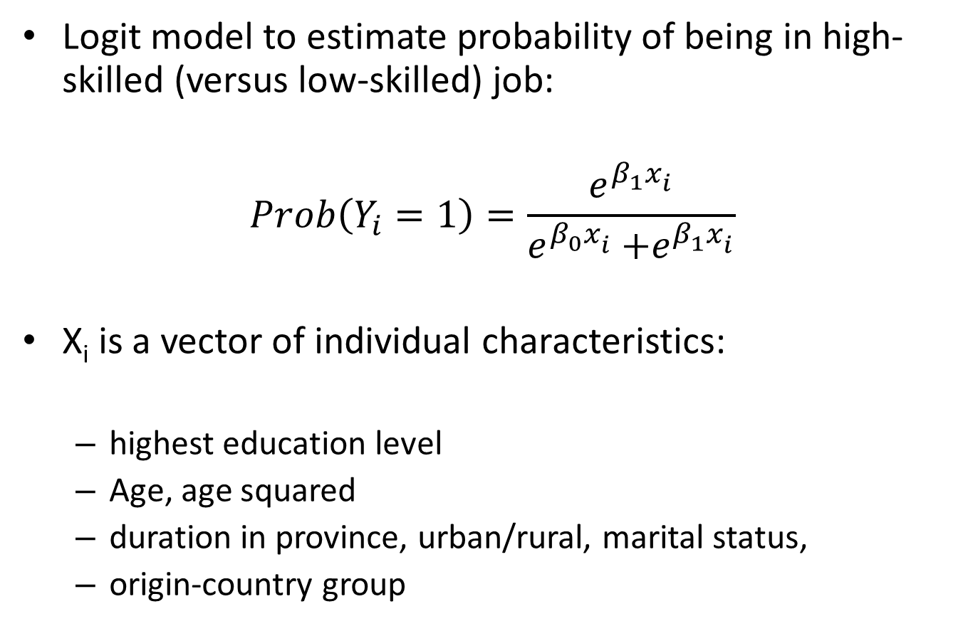
Framework
Logit model to estimate probability of being in high-skilled (versus low-skilled) job:
$$Prob\left(Y_{i}=1\right)=\frac{e^{β_{1}^{}x_{i}^{}}}{e^{β_{0}^{}x_{i}^{}}{+e}^{β_{1}^{}x_{i}^{}}}$$
X_{i} is a vector of individual characteristics:
highest education level
Age, age squared
duration in province, urban/rural, marital status,
origin-country group

Slide 11
Framework
We obtain predicted probabilities of obtaining a high-skilled job for each origin-country group
Probabilities are relative to the benchmark:
Native internal migrants
Better comparison group, since they are likely to be positively selected on unobserved factors
For a subset of non-OECD country groups:
We estimate the probability of being employed in a skilled, unskilled formal and unskilled informal job

Slide 12
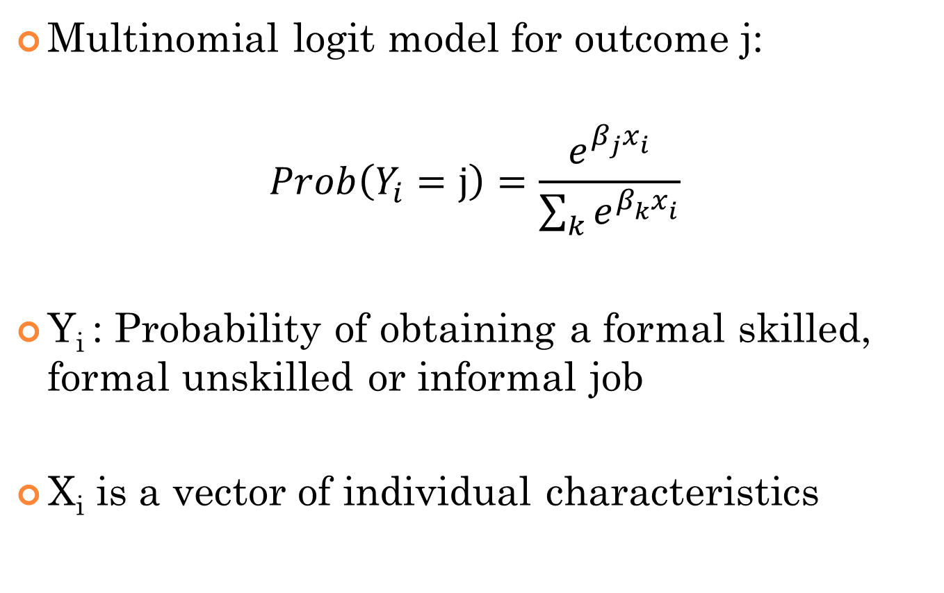
Framework
Multinomial logit model for outcome j:
$$Prob\left(Y_{i}=j\right)=\frac{e^{β_{j}^{}x_{i}^{}}}{\sum_{k}{e^{β_{k}^{}x_{i}^{}}}}$$
Y_{i} : Probability of obtaining a formal skilled, formal unskilled or informal job
X_{i} is a vector of individual characteristics

Slide 13
Data
We use South African census data for 2001.
We look at 30 origin-country groups and native internal migrants.
Occupations classified into skilled (professional, skilled, semi-skilled), unskilled.
We exclude farming activities and the unemployed.
Notes:
Skilled: legislators, officers, managers, professionals and technicians. Unskilled: clerks, service workers, shop and market sales workers, craft and related trade workers, plant and machine operators, assemblers and elementary occupations including cleaners, vendors and labourers.

Slide 14
Sample
Males, between ages 25 and 65
Recent migrants: arrived in current province between 1996 and 2001
For immigrants:
Restrict to those who arrived at an age where education was likely to have been obtained abroad

Slide 15
Immigrants in SA

Slide 16
Data description
 | Immigrants |  | Internal Migrants
Sample Size | 3 919 |  | 45 276
Distribution by Educational Attainment
No Schooling | 13.2% |  | 6.9%
Primary School | 17.6% |  | 18.7%
High School (matric equivalent) | 44.6% |  | 57.3%
Undergraduate Degree or Diploma | 16.0% |  | 13.7%
Masters or Doctorate Degree | 8.7% |  | 3.3%
Distribution by Occupation Type
Formal Sector: | 77.4% |  | 88.3%
- Unskilled Worker | 50.1% |  | 59.3%
- Skilled Worker | 27.3% |  | 29.0%
Informal Sector: | 22.6% |  | 11.7%
- Unskilled Worker | 19.8% |  | 10.1%
- Skilled Worker | 2.8% |  | 1.6%

Slide 17
Results: Probability of obtaining skilled employment
Country/Region | Undergraduate | Postgraduate | Country/Region | Undergraduate | Postgraduate
RSA | 73.6 | 89.6
Namibia & Botswana | 80.5 | 92.7 | China | 78.5 | 91.9
Lesotho | 47.3 | 73.5 | East Asia | 84.9 | 94.6
Zimbabwe | 73.4 | 89.5 | South East Asia | 48.6 | 74.5
Mozambique | 55.3 | 79.3 | Bangladesh, Nepal, SL | 65.8 | 85.6
Swaziland | 63.2 | 84.1 | India | 73.0 | 89.3
Angola | 68.4 | 87.0 | Pakistan | 54.8 | 78.9
Malawi & Zambia | 68.0 | 86.7 | North America | 73.9 | 89.7
Congo & Gabon | 57.2 | 80.5 | Australasia | 94.4 | 98.1
DRC & Cameroon | 53.1 | 77.8 | UK & Ireland | 89.8 | 96.5
Tanzania | 76.8 | 91.1 | Western Europe | 92.7 | 97.5
Kenya | 66.9 | 86.2 | Germany & Austria | 79.0 | 92.1
Burundi, Rwanda & Uganda | 72.1 | 88.9 | Eastern Europe | 74.6 | 90.1
East Africa | 62.8 | 83.9 | Mediterranean Europe | 67.6 | 86.6
Nigeria | 65.7 | 85.5 | Scandinavia | 61.8 | 83.3
West Africa | 42.9 | 69.9
North Africa | 93.5 | 97.8

Slide 18
Results: Probability of obtaining unskilled informal employment

Slide 19
Results: Probability of obtaining unskilled informal employment

Slide 20
Figure: Gradients

Slide 21
Figure: Gradients

Slide 22
Correlations: Probability of Skilled formal employment with Origin country characteristics

Slide 23
Correlations: Probability of informal employment with Origin country characteristics

Slide 24
Figure: Employment Gradients

Slide 25
Summary of results
There is substantial variation (by country of origin) among educated immigrants in the likelihood of finding a skilled job.
Immigrants from most African countries have a lower likelihood of obtaining a skilled job relative to natives.
Educated migrants from W. Africa, Kenya, Ethiopia, Somalia, Sudan and Eritrea have a high probability of obtaining an informal sector job.
We see that the variation in probabilities is lower at higher levels of education.
Source country characteristics are correlated with immigrant performance.
 | Positive | Negative
Obtaining a skilled job | GDP per capita, schooling quality | Presence of conflict
Obtaining an informal sector job | Presence of conflict, Distance to SA | English official language, GDP per capita

Slide 26
implications
Policy Implications:
Streamline immigration policy
Aid immigrant assimilation
Access to better information for employers
Easier accreditation

Slide 27
THANK YOU

Slide 28
Variable | Definition | Source
(log) Distance to South Africa | Kilometres between capital city of immigrant source country and South Africa | CEPII’s Distance Measures
Informality | % of the active labour force self-employed | La Porta and Schleifer (2008), accessed at http://faculty.tuck.dartmouth.edu/rafael-laporta/research-publications
Refugee Applications | Ratio of refugees and asylum seekers to total immigrant stock in 2000 | United Nations Commission for Refugees
Military conflict | A dummy variable which takes on the value 1 if there was military conflict in the home country during 1996-2001 | Variable constructed using www.prio.no, version 2.1 of the “Armed Conflict” database initiated by Gleditsch, Wallensteen, Eriksson, Sollenberg and Strand (2002)
English | English as an official language--dummy variable with value 1 if English is the official spoken language | CIA - The World Factbook, 2014.
Pupil-Teacher ratio | Number of pupils to teachers in an average class, 2001 | World Development Indicators.
(log) GDP per capita | per capita GDP adjusted for PPP, 2001 | World Development Indicators.

Slide 29
Country GROUPS
Lesotho
Namibia | Botswana
Zimbabwe
Mozambique
Swaziland
Angola
Democratic Republic of The Congo (Zaire) | Cameroon
Congo | Gabon
Malawi | Zambia
Tanzania
Algeria | Libya | Egypt | Iran | Israel | Jordan | Lebanon | Turkey | Morocco
Burundi | Rwanda | Uganda
Eritrea | Ehiopia | Somalia | Sudan
Ghana | Benin | Cote d'ivoire | Sierra Leone | Liberia | Senegal
Kenya
Nigeria
US | Canada
China | HK
Bangladesh | Nepal | Sri Lanka
India
Japan | South Korea | North Korea | Taiwan
Malaysia | Philippines | Singapore | Indonesia
Pakistan
UK | Ireland
Bulgaria | Croatia | Russia | Poland | Slovkia | Macedonia | Yugoslavia | Ukraine
Denmark | Finland | Netherlands | Norway | Sweden
France | Belgium | Switzerland
Germany | Austria
Portugal | Italy | Greece | Spain | Cyprus
Australia | New Zealand

